Slide 1
YES BANK STOCK CLOSING PRICE PREDICTION
CAPSTONE PROJECT
Presented By:
NAME - YASH SARIN
COLLEGE NAME - SRM INSTITUTE OF MANAGEMENT AND TECHNOLOGY
DEPARTMENT - B.TECH [ UG- COMPUTER SCIENCE AND ENGINNERING WITH SPECIALIZATION IN ARTIFICIAL INTELLIGENCE AND MACHINE LEARNING ]

Slide 2
OUTLINE
Problem Statement
Proposed System/Solution
System Development Approach
Algorithm & Deployment
Overview and Objective
Dataset
Result
Conclusion
References

Slide 3
Problem Statement
Yes Bank is a well-known bank in the Indian financial domain. Since 2018, it has been in the news because of the fraud case involving Rana Kapoor. Owing to this fact, it was interesting to see how that impacted the stock prices of the company and whether Time series models or any other predictive models can do justice to such situations. This dataset has monthly stock prices of the bank since its inception and includes closing, starting, highest, and lowest stock prices of every month.
The main objective is to predict the stock’s closing price of the month.

Slide 4
Proposed Solution
1. Data Understanding and Preparation
Dataset Review:
Examine the provided dataset containing monthly stock prices (closing, opening, highest, lowest) since the bank's inception.
Ensure data consistency, handle missing values, and potentially outliers.
Feature Selection:
Focus primarily on the closing price as the target variable for prediction.
Other features like opening, highest, and lowest prices can be used for additional analysis or feature engineering.
2. Exploratory Data Analysis (EDA)
Visualize the trends, seasonality, and any underlying patterns in the closing prices over time.
Use statistical techniques like autocorrelation function and partial autocorrelation function plots to understand dependencies.
3. Model Training
Spilt data into training and validation sets.
Train model on historical data and validate using out of sample data to assess performance.
4. Deployment:
Implement the model in a production environment for ongoing predictions.
Monitor model performance and retrain periodically if necessary.
5. Model Evaluation
Use metrics such as Mean Absolute Error (MAE), Mean Squared Error (MSE), and Root Mean Squared Error (RMSE) to evaluate model accuracy.
Compare different models to choose the best performing one.
6. Result

Slide 5
System Approach
System requirements : Windows 10/11 operating system , 6/8GB RAM, i5/i7 Processor, Python 3.11/3.10, Jupyter Notebook.
Library required to build the model :
NumPy
Panda
Matplotlib
Seaborn
Datetime
Sklearn

Slide 6
Algorithm & Deployment
Step 1- Dataset- Collection of dataset from Kaggle.
Step 2- Data Framing – Define the success metrics used , define the ideal outcome and models goals. Or what is observed and what should be predicted based on Problem Statement.
Step 3-Data Pre-Processing - Data processing is a crucial step in the machine learning (ML) , as it prepares the data for use in building and training the models.
Step 4- Exploratory data analysis (EDA)- Summarize the main characteristics according to the dataset.
Step 5- K-Nearest Neighbors (KNN)-The k-nearest neighbors (KNN) algorithm is a simple, supervised machine learning algorithm that can be used to solve both classification and regression problems. k-NN is a type of instance-based learning, or lazy learning, where the function is only approximated locally and all computation is deferred until function evaluation. Since this algorithm relies on distance for classification, normalizing the training data can improve its accuracy dramatically.
Step 6- Random Forest - Random Forest is an ensemble technique capable of performing both regression and classification tasks with the use of multiple decision trees and a technique called Bootstrap and Aggregation, commonly known as bagging.
Step 7- Implementation of Regression- We create 4 regression models for our data such as Linear Regression, Lasso Regression , Ridge Regression , Elastic Net Regression.
Step 8- Conclusion

Slide 7
STEPS
Data framing ( Based on problem statement)
Data inspection & pre-processing
Exploratory data analysis (EDA)
Model implementation
(KNN, Random Forest ,Linear Regression, Lasso Regression, Ridge Regression , Elastic Net Regression)
Conclusion

Slide 8
OVERVIEW AND OBJECTIVE
YES BANK Overview
Yes Bank is a well-known bank in the Indian financial domain. It has been in the headlines since 2018 as a result of the Rana Kapoor fraud case. Due to this, it was interesting to observe how it affected the company's stock prices and whether Time series models or other prediction models could properly reflect for such circumstances. Since the bank's founding, this dataset has included closing, starting, highest, and lowest stock prices for each month.
YES BANK Objective
This dataset has monthly stock prices of YES BANK since its inception and includes closing, starting, highest, and lowest stock prices of every month. The main objective is to predict the stock’s closing price of the month.

Slide 9
Datasets
YES BANK STOCK CLOSING PRICE PREDICTION DATASET
We have 185 rows and 5 columns in our dataset. Here our dependent variable is Close and Independent variable is Open, High and Low.
Date :- It denotes the month and year for a specific pricing.
Open :- The price at which a stock started trading that month is referred to as the "Open."
High :- The highest price for that particular month.
Low :- It describes the monthly minimum price.
Close :- It refers to the final trading price for that month, which we have to predict using regression.
Independent or input variables -: ‘ Open ’, ‘ High ’,‘ Low’
Dependent or target variable -: ‘ Close’
‘ Date ’is only useful for EDA purpose & don't have any influence for closing price prediction.

Slide 10
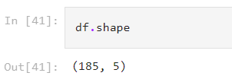
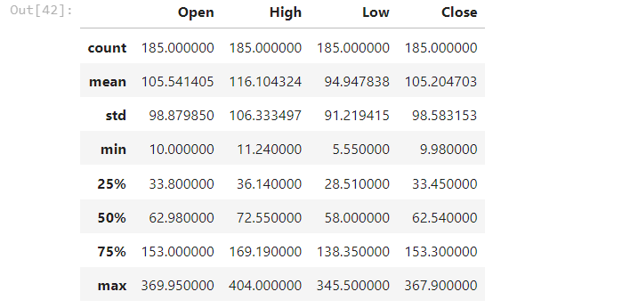
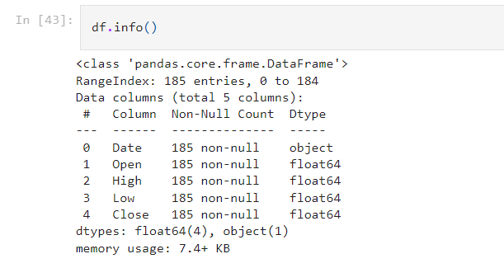
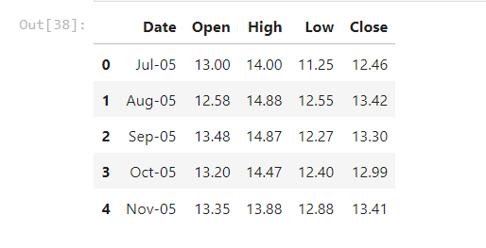
result
GitHub Link:
https://github.com/yashsarin/AICTE-EDUNET-YES-BANK-STOCK-CLOSING-PRICE-PREDICTION
Data Framing:
Shape of the Data
●Datatype in Data Frame
5 value in the datasets Description of datasets

Slide 11
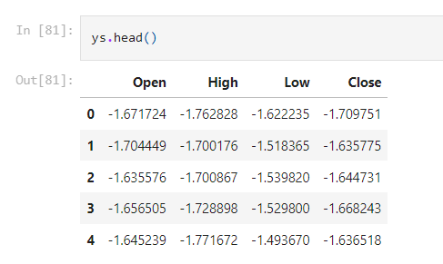
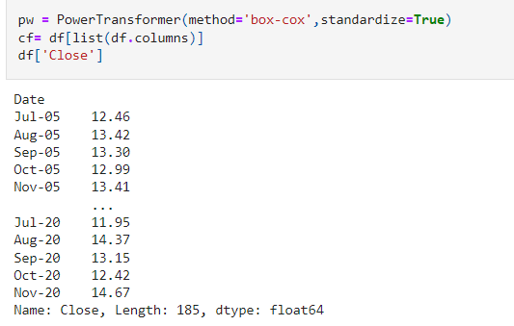
Result cont..
Data Preprocessing
Power Transform

Slide 12
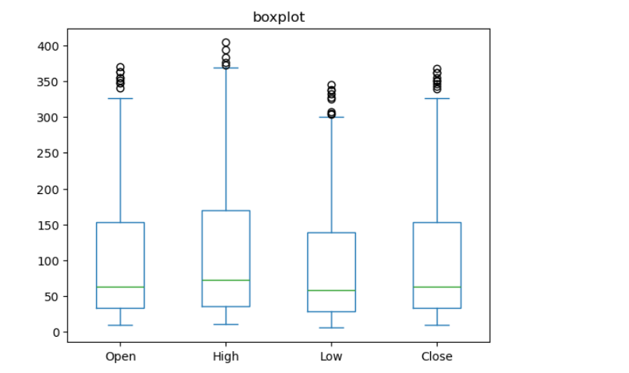
Result cont..
Exploratory Data Analysis:
Univariate Analysis:-
In our yes bank stock market dataset all the features have normally distributed after log transformations.

Slide 13
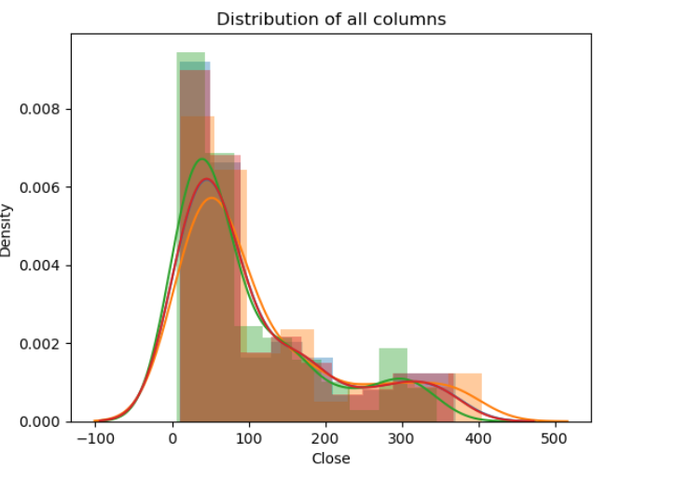
Result cont..
Visualization of Distribution of all Columns of Closing Price:

Slide 14
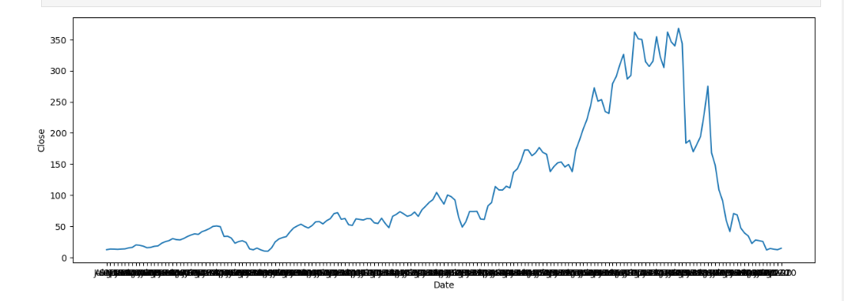
Result cont..
Exploratory Data Analysis:
Bivariate Analysis-:
In the context of supervised learning, it can help determine the essential predictors when the bivariate analysis is done by plotting one variable against another. The graphs below depict that there is a high correlation between the dependent (Close) and independent variables.

Slide 15
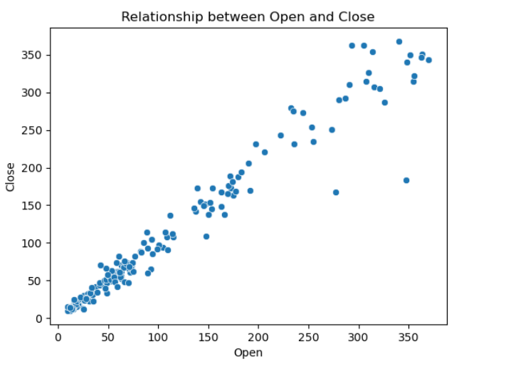
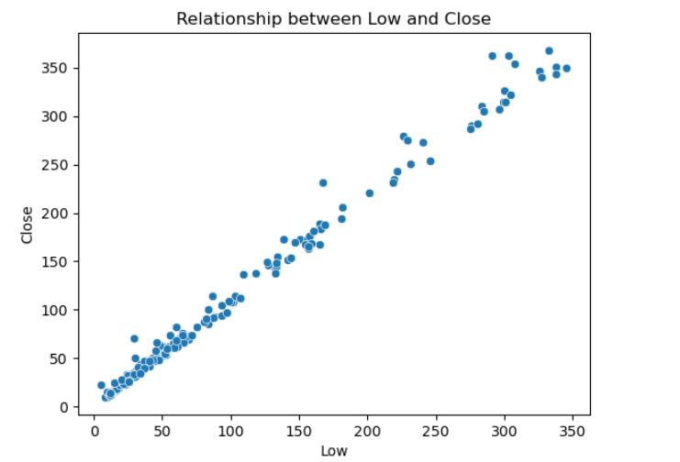
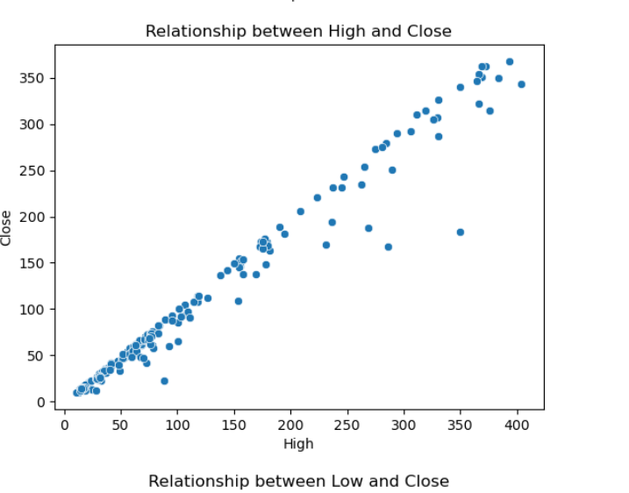
Result cont..
Visualization of Relationship of all Datasets of Closing Price
Relationship between Open and Relationship between Low and Relationship between High and
Close Close Close

Slide 16
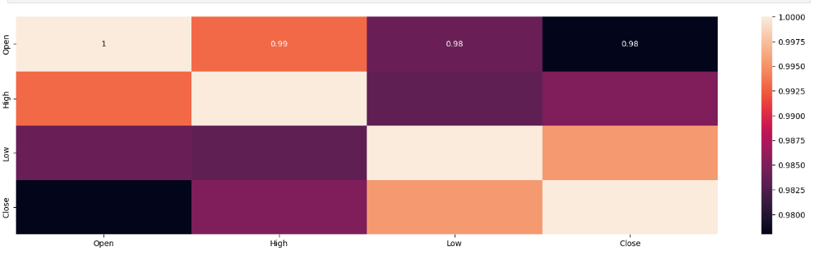
Result cont..
Exploratory Data Analysis:
Multivariate Analysis

Slide 17
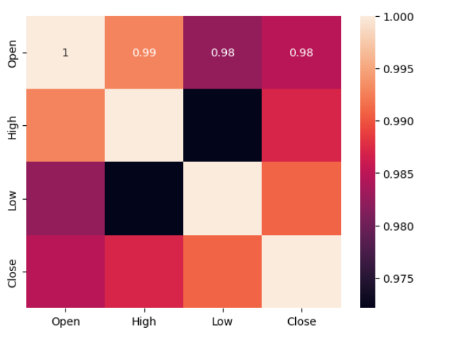
Result cont..
Correlation:
Correlation analysis is a method of statistical evaluation used to study the strength of a relationship between numerical variables. This heatmap shows us the correlation between all numerical variables in our data. Every feature is extremely correlated with each other, so taking just one feature or average of these features would suffice for our regression model as linear regression assumes there is no multicollinearity in the features. We will try to reduce multicollinearity using thetransformation of variables.

Slide 18
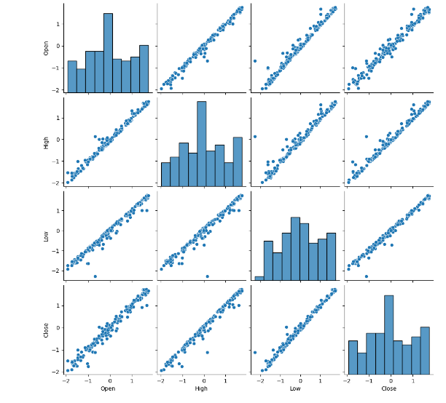
Result cont..
Visualization of every single column of our Data Frame against every other column.

Slide 19
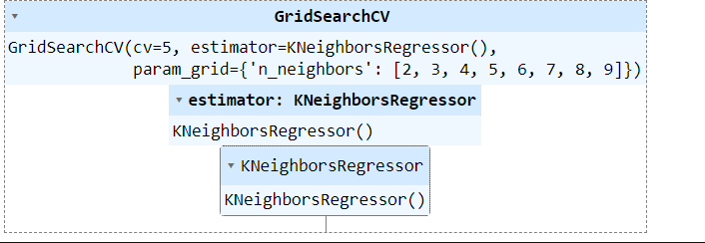
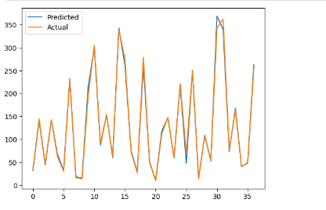
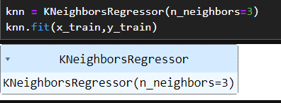
Result cont..
K-Nearest Neighbors (KNN):
The k-nearest neighbors (KNN) algorithm is a simple, supervised machine learning algorithm that can be used to solve both classification and regression problems. k-NN is a type of instance-based learning, or lazy learning, where the function is only approximated locally and all computation is deferred until function evaluation. Since this algorithm relies on distance for classification, normalizing the training data can improve its accuracy dramatically.

Slide 20
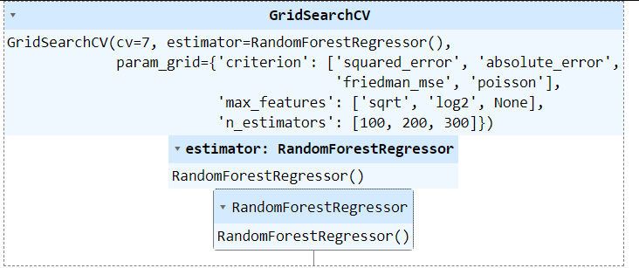
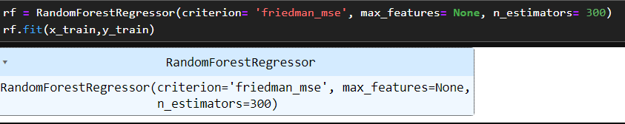
Result cont..
Random Forest:
Random Forest is an ensemble technique capable of performing both regression and classification tasks with the use of multiple decision trees and a technique called Bootstrap and Aggregation, commonly known as bagging.

Slide 21

Result cont..
Regression Model:
Linear Regression:
Linear regression is the most basic machine learning approach that can be applied to this data. The result of the linear regression model is an equation showing how the independent variables and dependent variable related to each other.

Slide 22
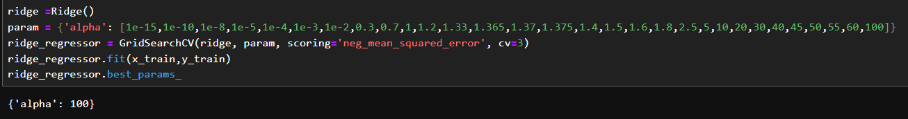
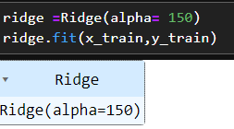
Result cont..
Ridge Regression:
Ridge regression is a model-tuning technique that is used to analyze any multicollinear data. L2 regularization is done using this technique. The projected values vary significantly from the actual values when the problem of multicollinearity is present, least-squares are unbiased, and variances are large.

Slide 23
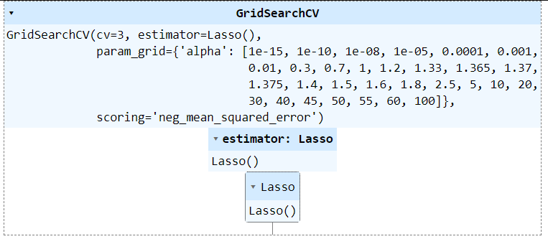
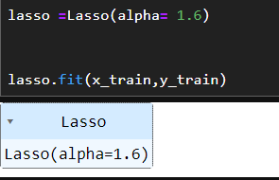
Result cont..
Lasso Regression:
Lasso(least absolute shrinkage and selection operator) regression is another technique of Parameter estimation regression method. This method is usually used in machine learning for the selection of the subset of variables. It provides greater prediction accuracy as compared to other regression models. Lasso Regularization enhances the accessibility of models.

Slide 24
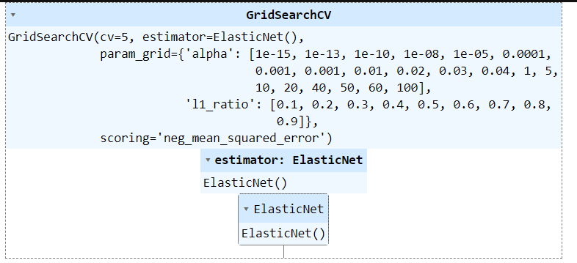
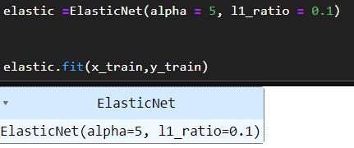
Result cont..
Elastic Net Regression:
Elastic net regression works in a manner that takes the best of lasso and ridge regressions. It adds up the penalty terms for regularization in lasso and ridge (L1 and L2) and uses that for regularization. It is used for regularization in order to enhance the prediction accuracy and interpretability of the resulting statistical model.

Slide 25
Conclusion
The trend of the price of Yes Bank's stock increased until 2018 and then Close, Open, High, Low price decreased.
Based on the open vs. close price graph, we concluded that Yes Bank's stock fell significantly after 2018.
Both duplicate and null values are absent, as we have seen. But object data type values are available for the Date feature.
The dependent and independent values were found to be linearly related.
The data contained a significant amount of multicollinearity.
Decision Tree regression Is best model for yes bank stock closing price data this model use for further prediction
Visualization has allowed us to notice that the closing price of the stock has suddenly fallen starting in 2018. It seems reasonable that the Yes Bank stock price was significantly impacted by the Rana Kapoor case fraud.
KNN performed the worst out of all.
● In this work, we create 4 regression models for our data:-
1. Linear Regression ● 2. Lasso Regression ● 3. Ridge Regression 4. Elastic Net Regression
●These four models gives us the following results: High, Low, Open are directly correlate with the closing price of the stocks.

Slide 26
References
https://www.kaggle.com/datasets/simranjain17/yes-bank-stock-prices
https://www.youtube.com/watch?app=desktop&v=lx-dcCr0JCI
https://www.indiapropertydekho.com/article/154/yes-bank-share-price-target

Slide 27
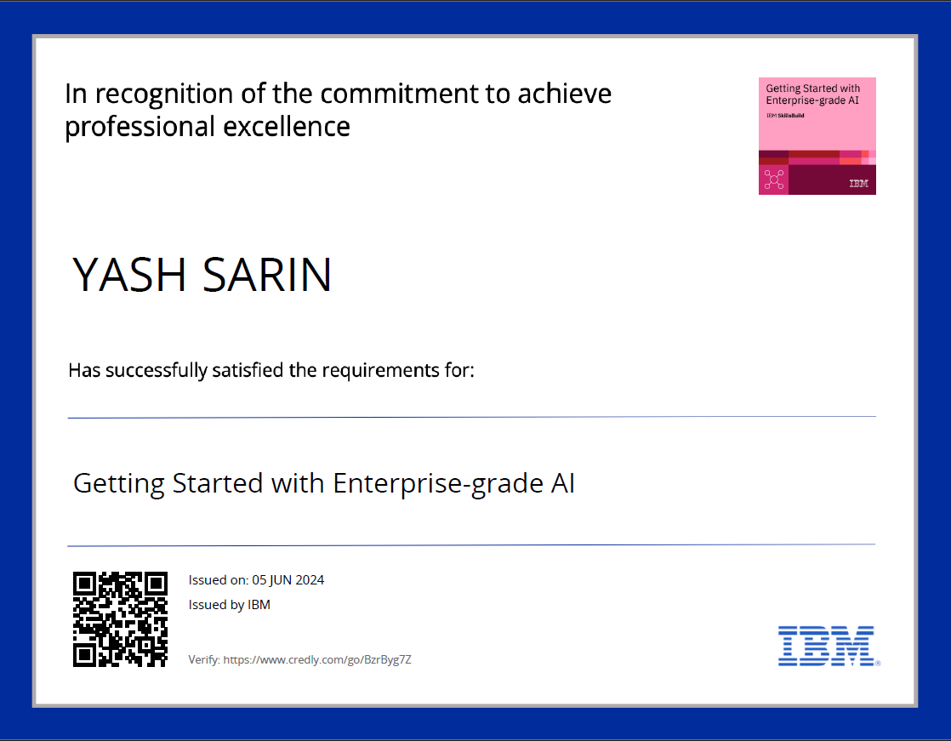
course certificate 1
https://www.credly.com/badges/d9ad8a85-e908-4712-8f2e-4164942d15fa/public_url

Slide 28

course certificate 2
https://www.credly.com/badges/bcecd975-6565-4792-9166-3d5c33c55798/public_url

Slide 29
THANK YOU

